Slide 1
PPI Project
Chipset_8255

Slide 2

Group(2):
Eslam Tarek Fawzey Sec(1)
Amr Samy Ahmed Sec(2)
Abanoub Michael Eissa Sec(1)

Slide 3
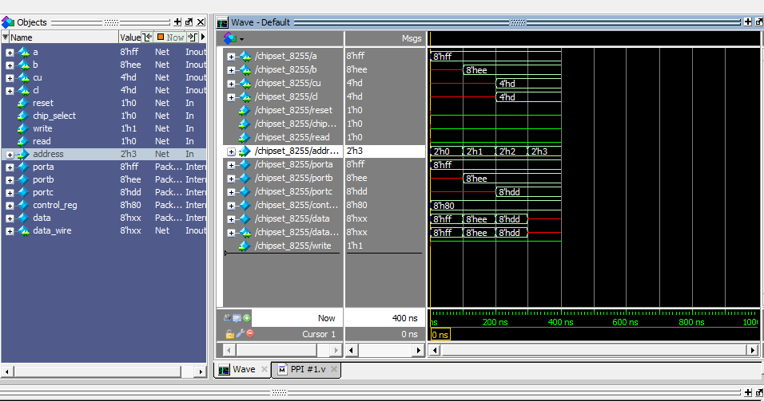
Read from port A,B,C

Slide 4
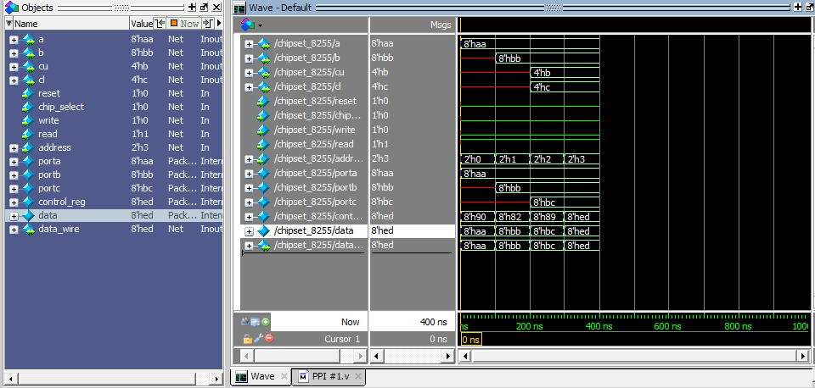
and Control reg. Write on port A,B,C

Slide 5
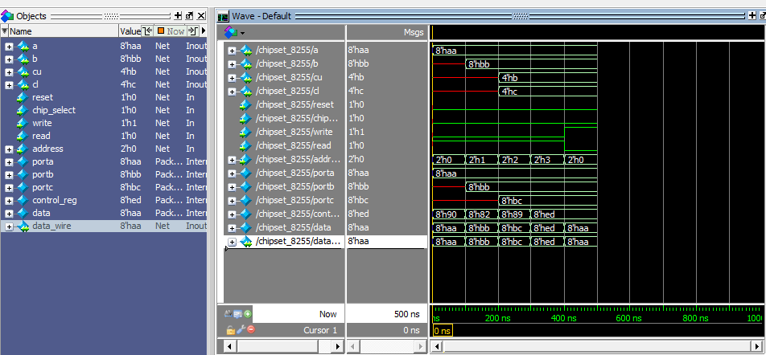
Write then read from any port

Slide 6
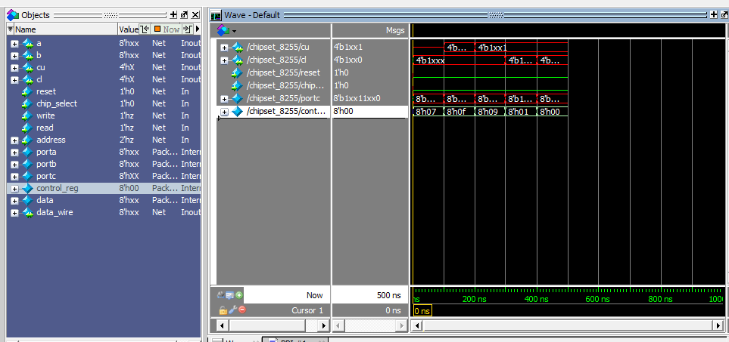
BSR mode

Slide 7
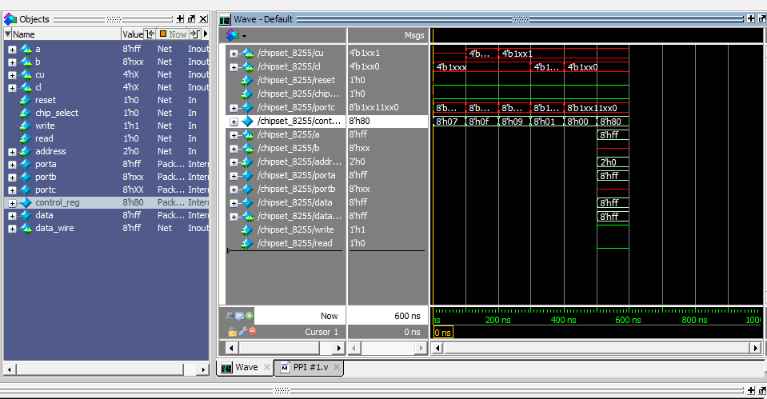
BSR then I/O mode

Slide 8
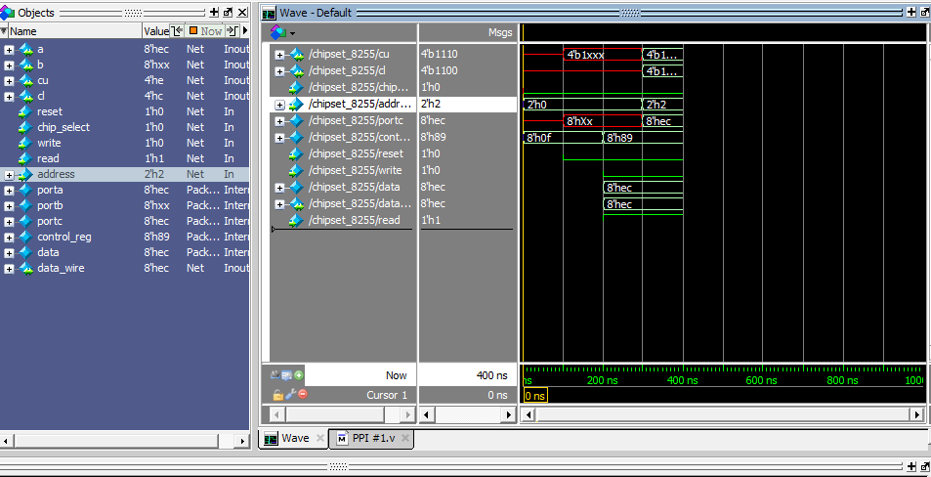
BSR then Write on Port C

Slide 9
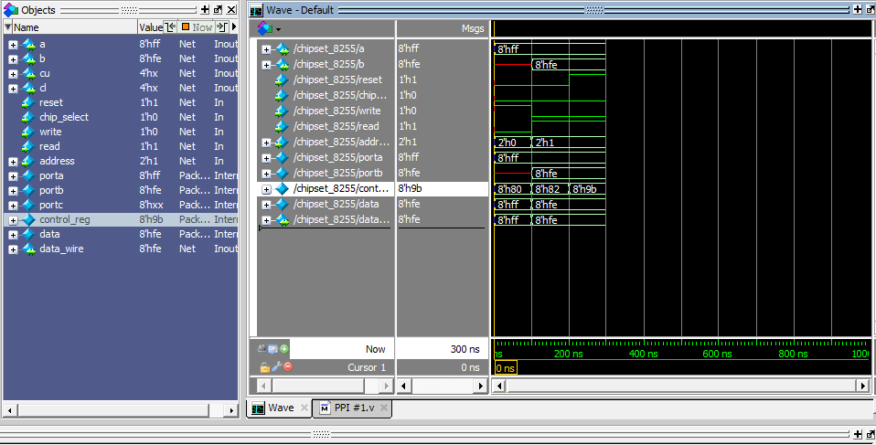
Reset

Slide 10
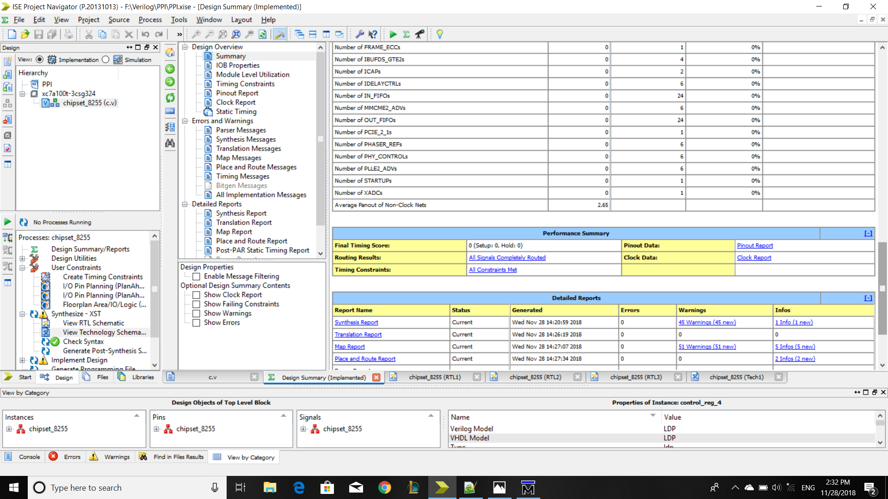
Synthesis

Slide 11
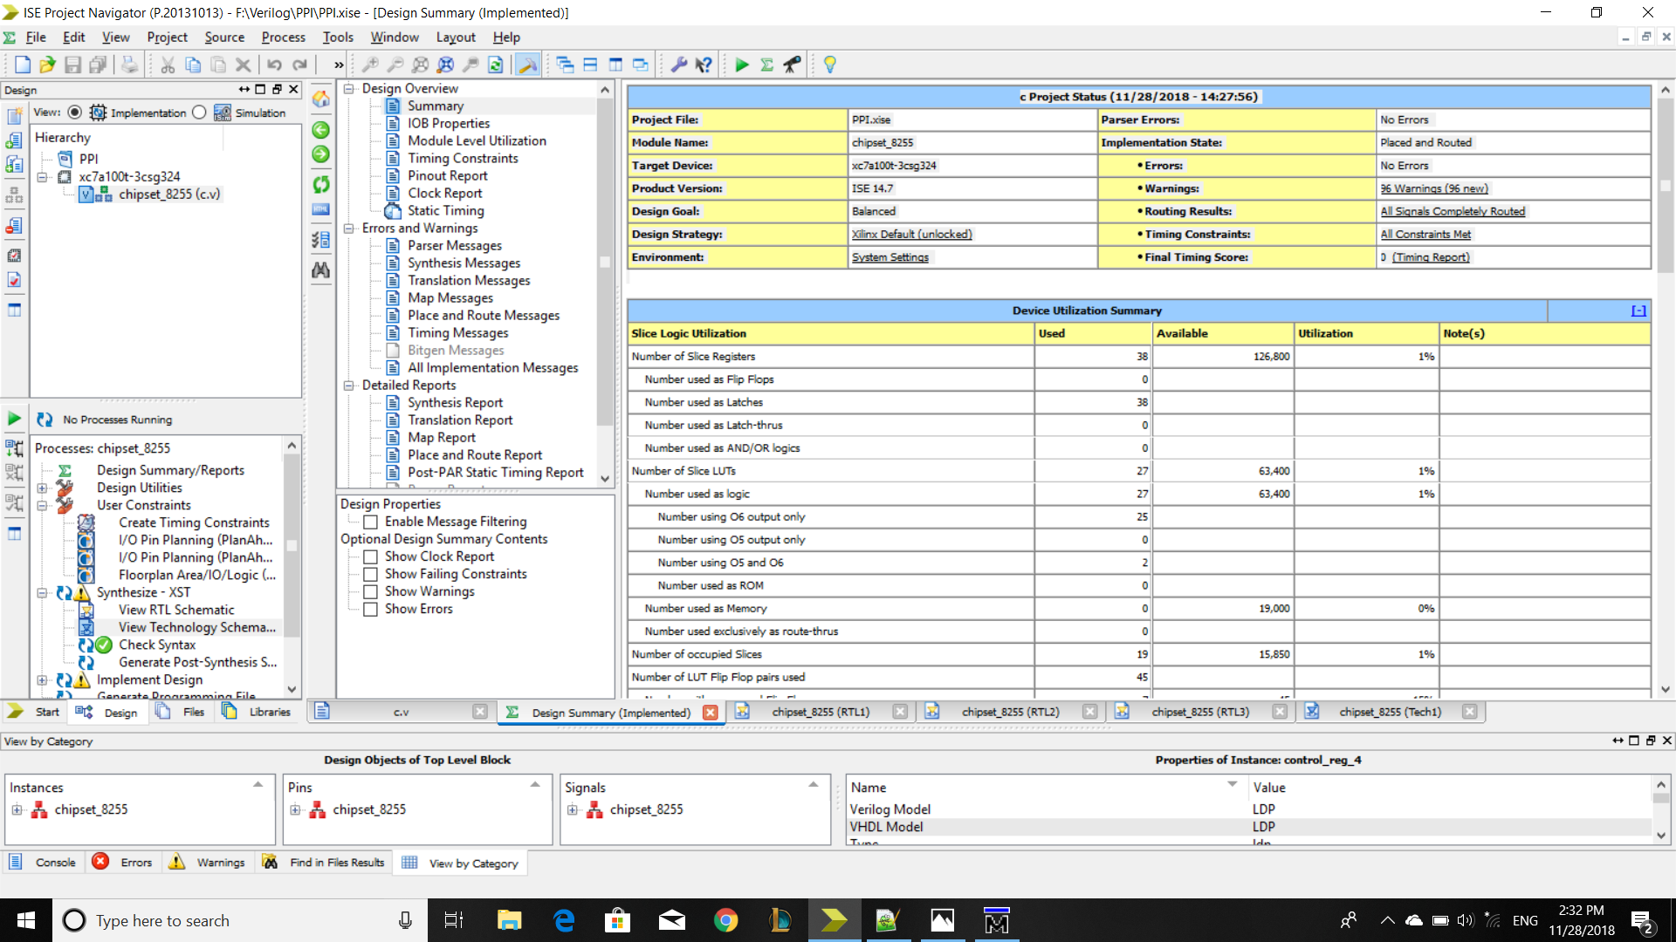

Slide 12
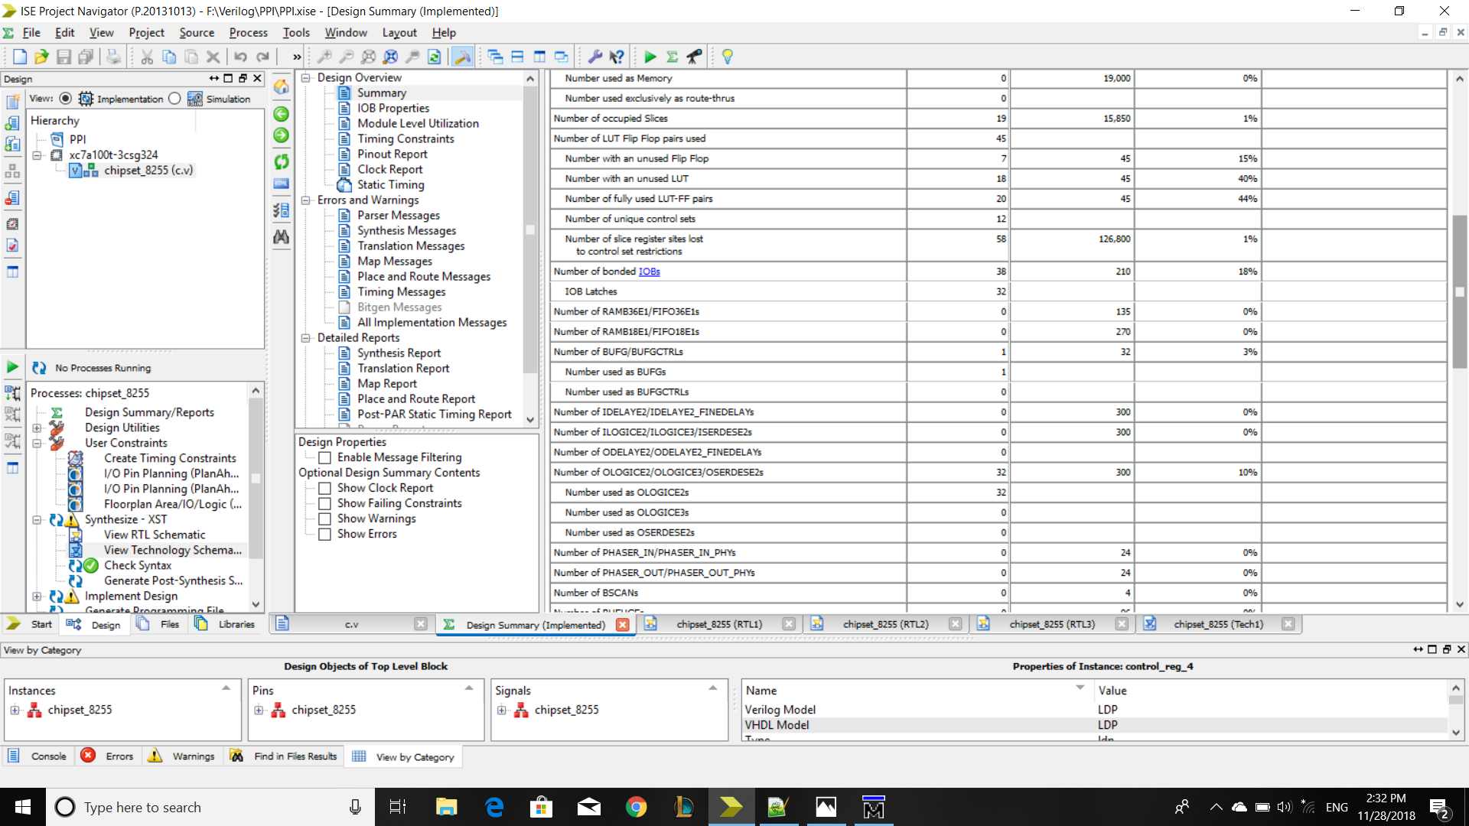

Slide 13


Slide 14
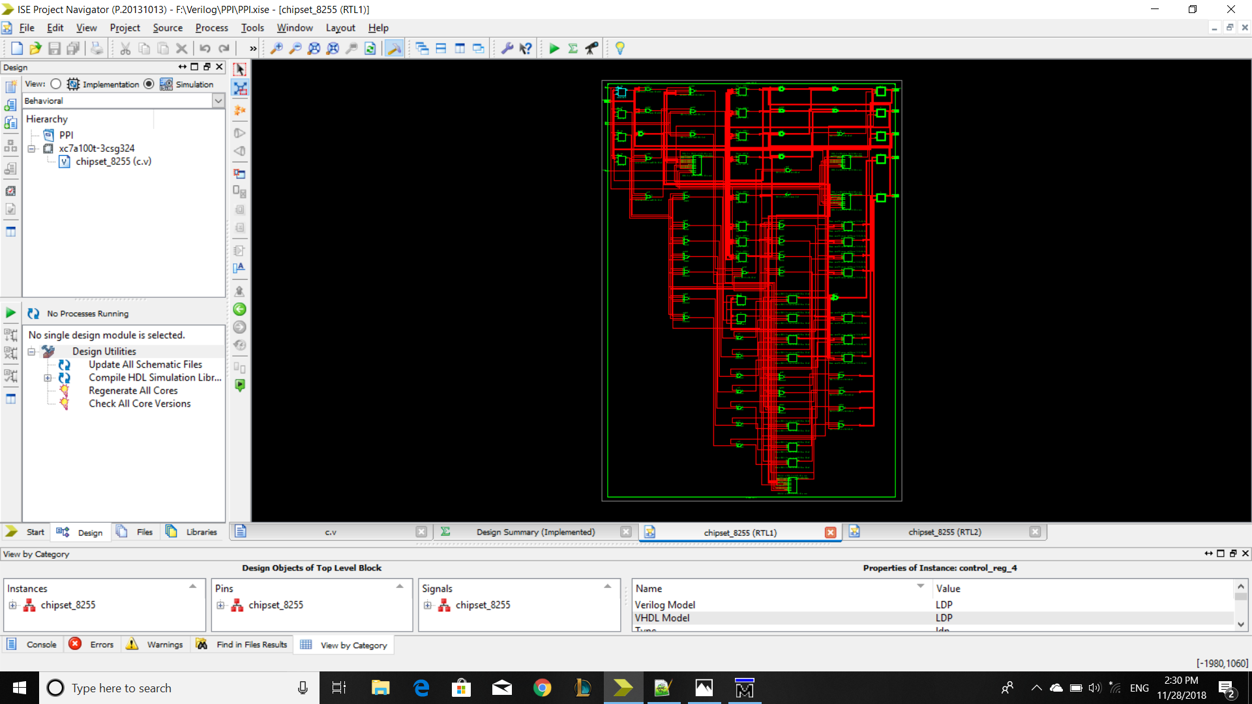
Schematic

Slide 15
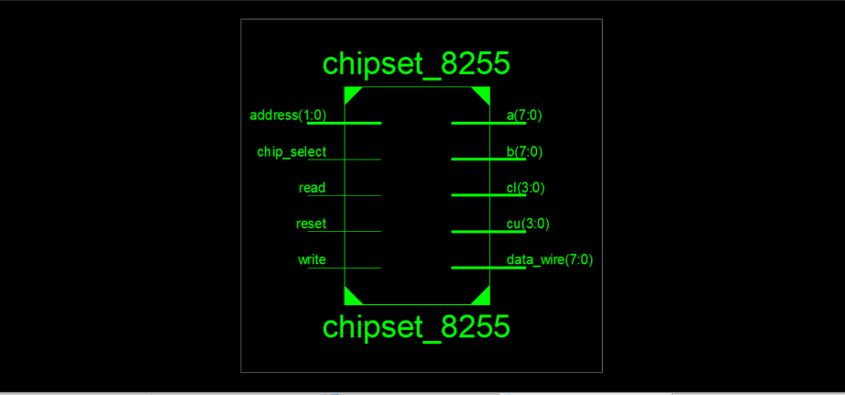
Finallyyyyyyyyyyy :D

